Slide 1
Monolith to MicroServices
Pravin Y Pawar

Slide 2
Changing World
App development and deployment
Application development and IT system management revolution is driven by the cloud
Operational efficiency and faster-time-to-market is being enabled by
Fast, agile, inexpensive, and massively scalable infrastructure
fully self-service applications
pay-as-you-go billing model
emergence of containers etc.
Companies are finding it difficult to make their applications highly available, scalable and agile
Competitive business pressures demand that applications continuously
evolve
add new features
remain available 24x7
For example, no longer acceptable for a bank website to have a maintenance window!

Slide 3
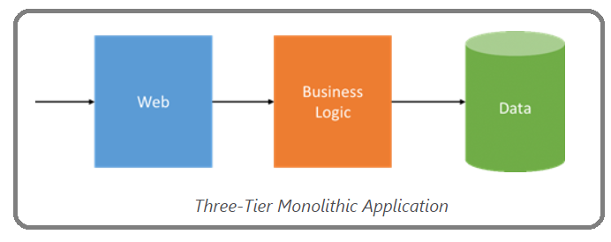
Monolithic application models
Three tier
For decades, application development is influenced by the cost, time, and complexity of provisioning new hardware
More pronounced when those applications are mission-critical
IT infrastructure is static, applications were written to be statically sized and designed for specific hardware
Applications were decomposed to minimize overall hardware requirements and offer some level of agility and independent scaling
classic three-tier model, with web, business logic and data tiers
each tier was still its own monolith, implementing diverse functions
combined into a single package deployed onto hardware pre-scaled for peak loads
When load caused an application to outgrow its hardware, the answer was typically to “scale up”
Source : Microsoft

Slide 4
Monolithic application
Challenges
Natural result of the limitations of infrastructure agility
resulted in inefficiencies
little advantage to decomposing applications beyond a few tiers
Challenges
A tight coupling between unrelated application services within tiers
A change to any application service, even small ones, required its entire tier to be retested and redeployed
A simple update could have unforeseen effects on the rest of the tier - changes are risky
Lengthening development cycles to allow for more rigorous testing
An outright hardware failure could send the entire application into a tailspin

Slide 5
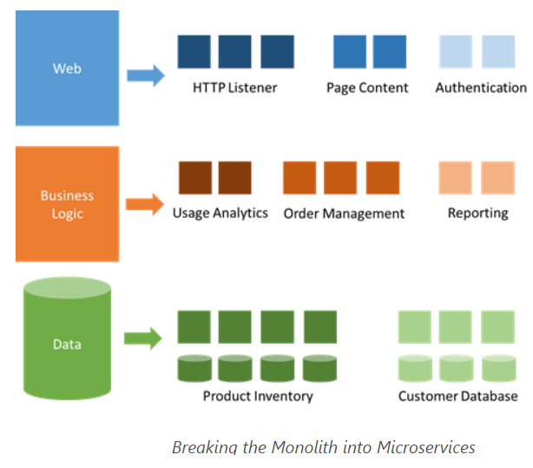
Solution
Microservices
Microservices are a different approach to application development and deployment
perfectly suited to the agility, scale and reliability requirements of many modern cloud applications
A microservices application is decomposed into independent components called “microservices,”
work in concert to deliver the application’s overall functionality
Emphasizes the fact that applications should
be composed of services small enough to truly reflect independent concerns such that each microservice implements a single function
have well-defined contracts (API contracts) – typically RESTful - for other microservices to communicate and share data with it
be able to version and update independently of each other
Loose coupling is what supports the rapid and reliable evolution of an application
Source : Microsoft

Slide 6
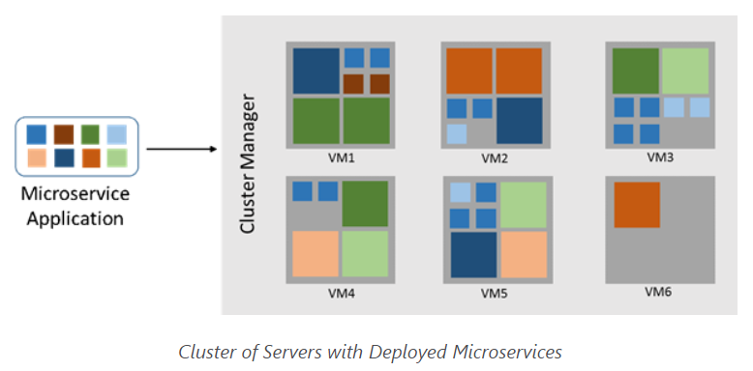
Micorservices
Fast Deployments
For Monolithic applications developers declare resource requirements to IT
Microservices
enable the separation of the application from the underlying infrastructure on which it runs
declare their resource requirements to a distributed software system known as a “cluster manager"
“schedules,” or places, them onto machines assigned to the cluster
Commonly packaged as containers and many usually fit within a single server or virtual machine
deployment is fast and they can be densely packed to minimize the cluster’s scale requirements
Source : Microsoft

Slide 7
Micorservices
Easier Deployments
Microservices-based applications are independent and distributed in nature
Enables rolling updates
only a subset of the instances of a single microservice will update at any given time
If a problem is detected, a buggy update can be “rolled back,” or undone
If the update system is automated and integrated with Continuous Integration (CI) and Continuous Delivery (CD) pipelines
allow developers to safely and frequently evolve the application without fear of impacting availability

Slide 8
Thank You!
Reference :
Microservices: An application revolution powered by the cloud
Mark Russinovich Chief Technology Officer, Microsoft Azure
In our next session:

